Slide 1
Core Java final project-bank customer details
nAME : Ashnisha Doundkar
Employee_id :194553

Slide 2
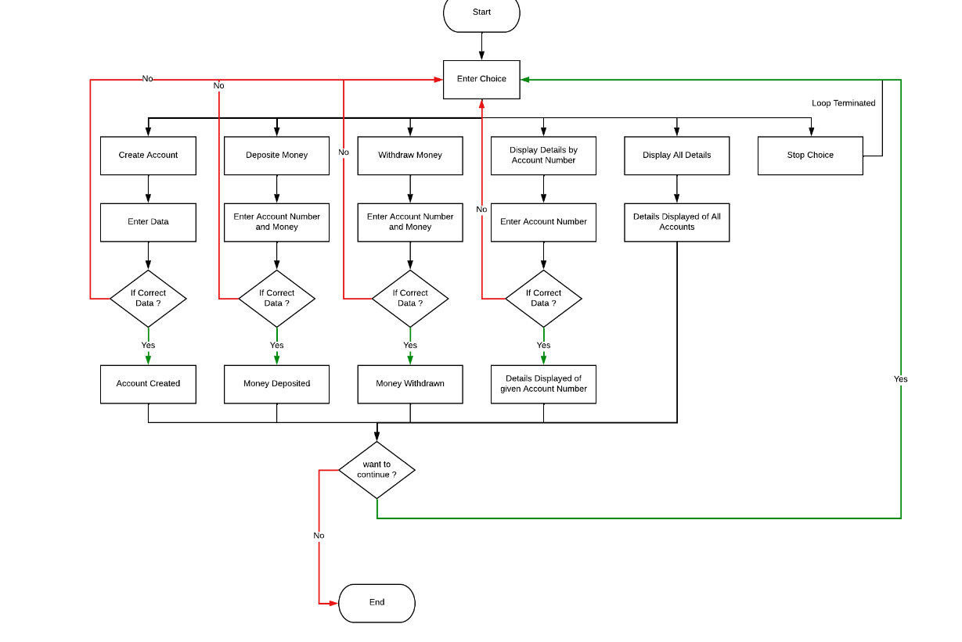
Flowchart

Slide 3
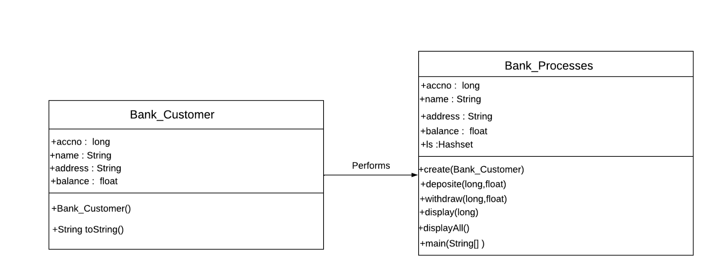
Class diagram

Slide 4
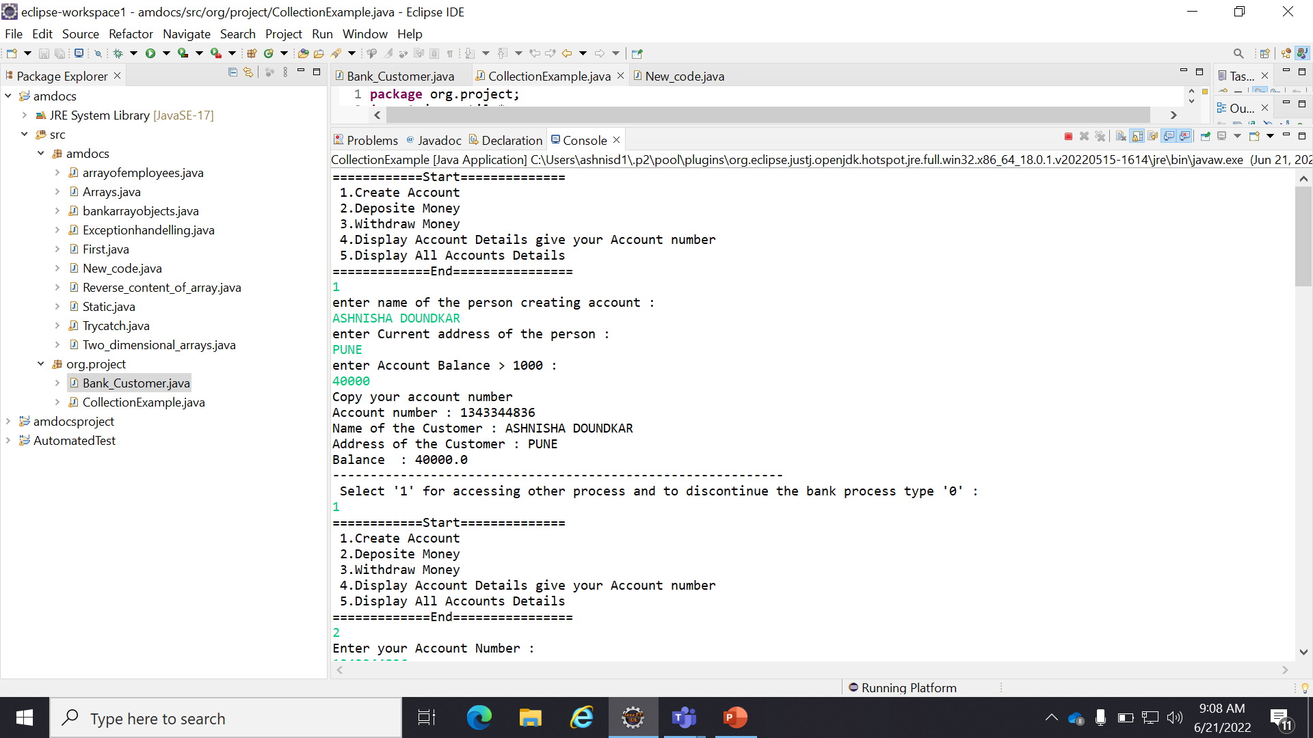
outputs

Slide 5
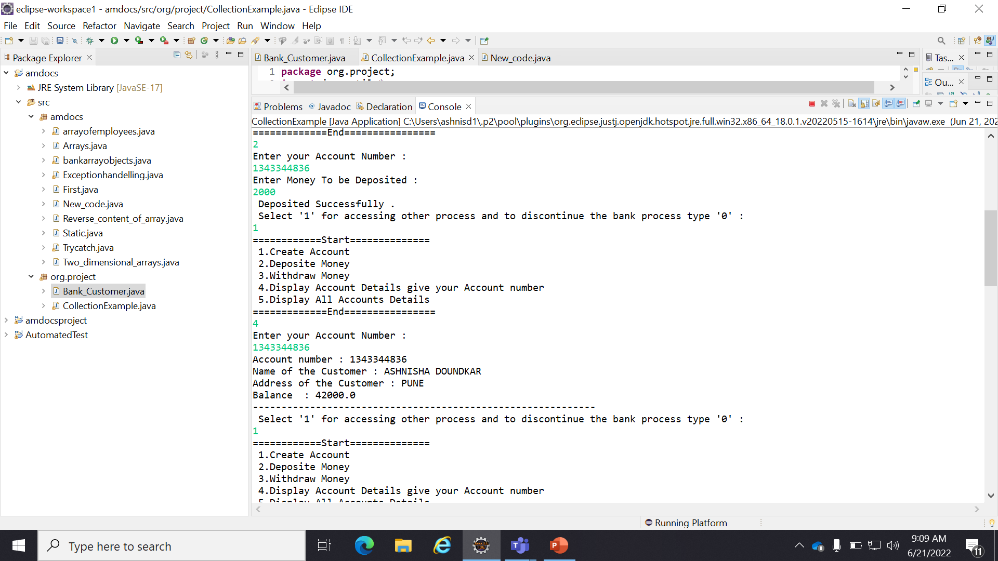
OUTPUT

Slide 6
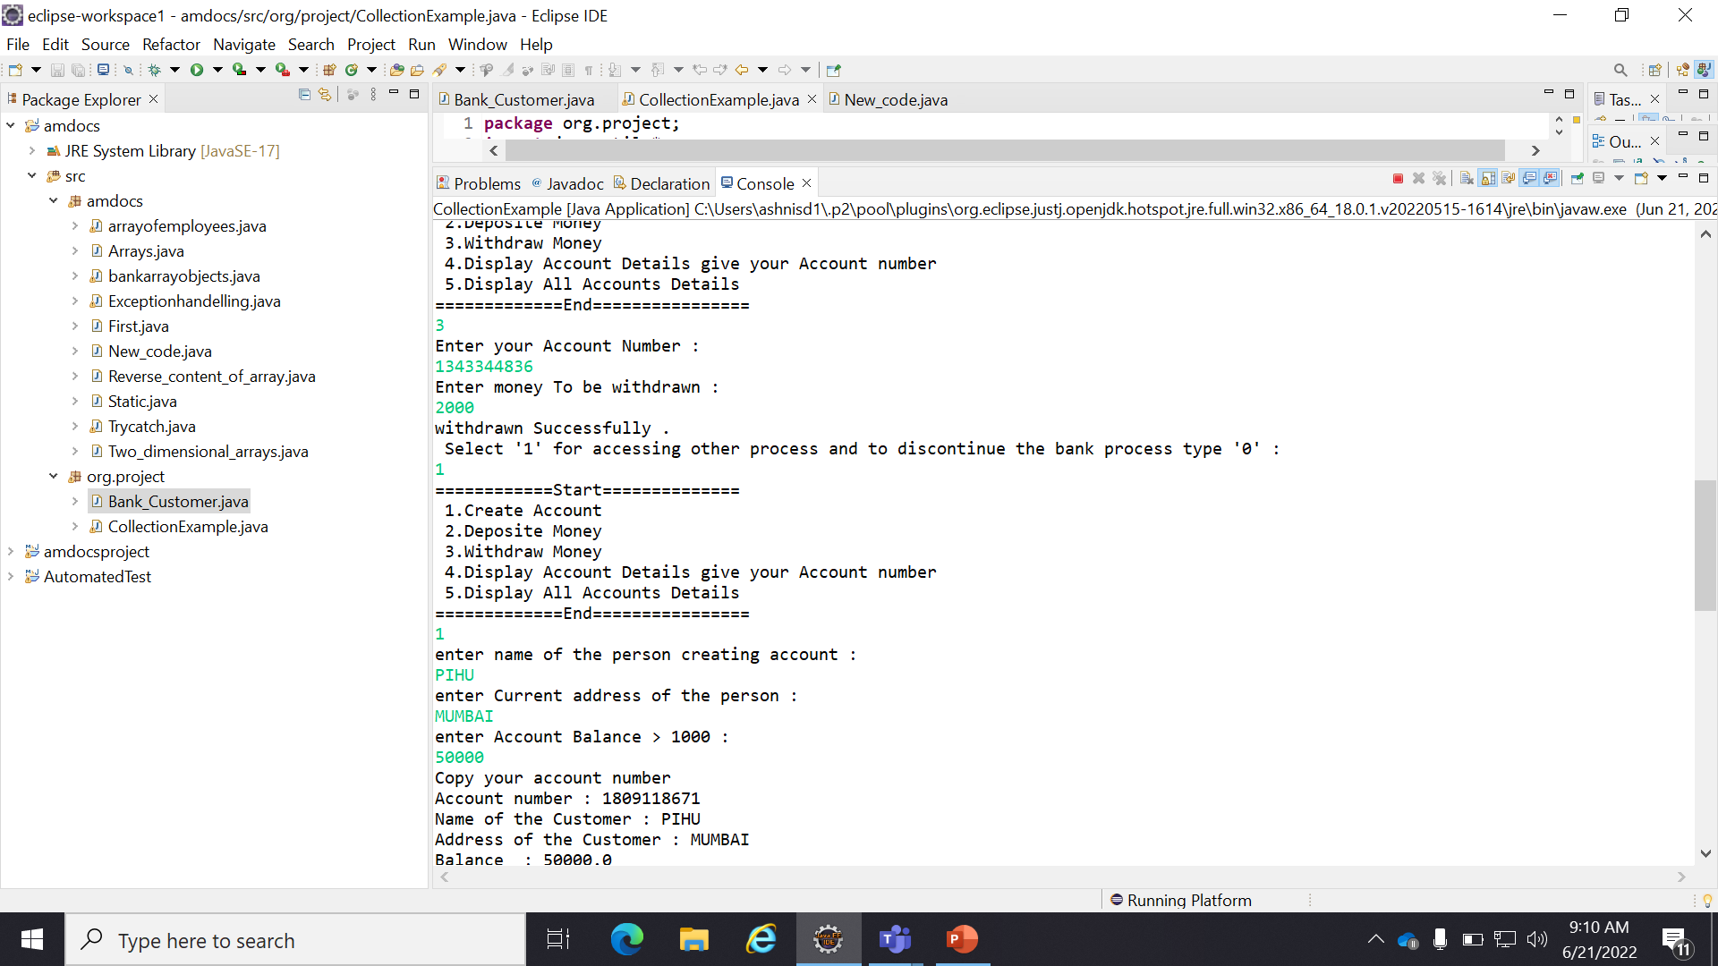
OUTPUT

Slide 7
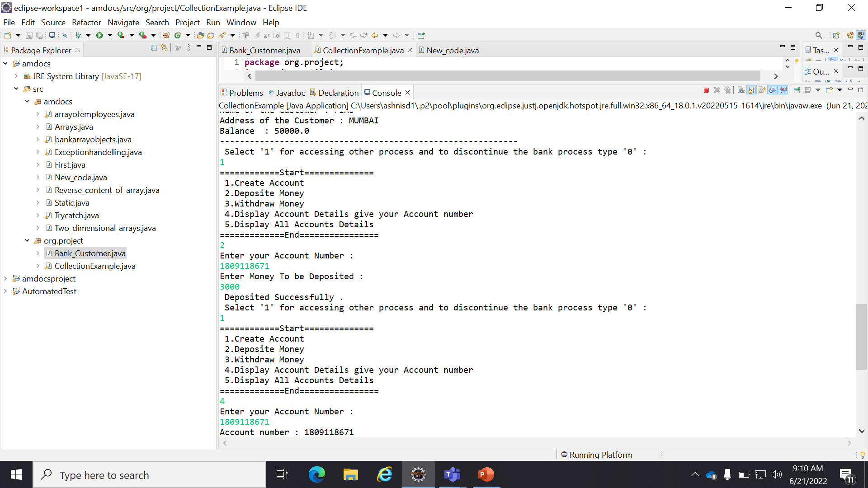
OUTPUT

Slide 8
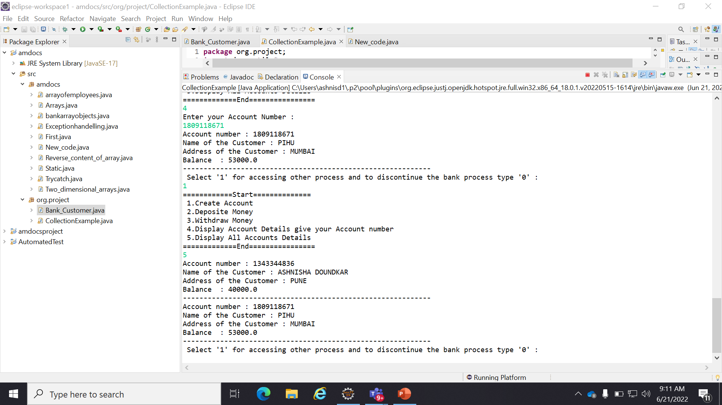
OUTPUT

Slide 9
THANK YOU

